Slide 1
CROSS-PLATFORM MOBILE
MALWARE: WRITE ONCE, RUN
EVERYWHERE
Ardi Vaba
Cyber Security Engineering
Estonian Information Technology College

Slide 2
CROSS-PLATFORM MALWARE
CROSS-PLATFORM MOBILE MALWARE: WRITE ONCE, RUN EVERYWHERE
William Lee & Xinran Wu Sophos, Australia
https://www.sophos.com/en-us/medialibrary/PDFs/technical%20papers/sophos-Lee-Wu-crossplatform-mobile-malware-VB2015.pdf?la=en

Slide 3
CROSS-PLATFORM MALWARE
Term | Definition
Malware | Hostile or intrusive software.
PUA | Potentially unwanted application.
iOS | Closed-Source operating system developed by Apple.
Android | Open-Source operating system developed by Google.

Slide 4
CROSS-PLATFORM MALWARE
Term | Definition
Framework | Platform for developing software applications.
.NET | Cross-Platform software framework developed by Microsoft.
HTML | Standard markup language for creating web pages and web applications.
Open-source | Software with source code made available.

Slide 5
CROSS-PLATFORM MALWARE
Current state of cross-platform malware
Options for cross-platform malware
Code examples

Slide 6
CROSS-PLATFORM MALWARE
Write code using a single framework
Run same code basically everywhere
Desktop, mobile, some IOT

Slide 7
CROSS-PLATFORM MALWARE
Cross-platform malware is getting increasingly more popular
Many frameworks that can enable you to write cross-platform malware with minimal effort

Slide 8
CROSS-PLATFORM MALWARE
PhoneGap (Adobe)
Titanium (Open-source)
Xamarin
Unity
Cocos2D (Open-source)

Slide 9
CROSS-PLATFORM MALWARE
 | Total | Malware | PUA
PhoneGap | 21,734 | 203 (0.9%) | 91 (0.4%)
Unity | 37,382 | 32 (0.08%) | 1351 (3.6%)
Xamarin | 345 | 0 | 0
Cocos2d | 831 | 6 (0.7%) | 253 (0.3%)

Slide 10
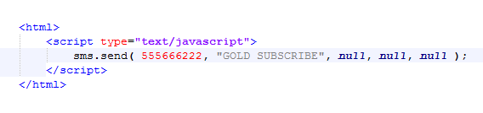
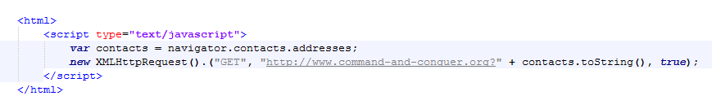
CROSS-PLATFORM MALWARE
PhoneGap SMS example:
PhoneGap Stealing contacts example:

Slide 11
CROSS-PLATFORM MALWARE
I talked about different frameworks that enable you to write cross-platform malware. I touched on the malware statistics relative to these frameworks and showed some code examples how simple it is to write cross-platform code that has malicious purposes.

Slide 12
CROSS-PLATFORM MALWARE
Many options
Increasingly popular
Serious security implications

